Slide 1
Credit Card Default - Part A
Kothari Himanshi
M14529802

Slide 2
About Credit Card Data
Dimensions of data – 30,000 observations and 23 attributes
Default attribute is binary response (Categorical) – default payment next month (1 – Yes, 0 – No) – Response variable
Proportion of default is 22% of the total data (~6.6k of 30k observations)

Slide 3
Data Dictionary – Predictor Variables
Predictor 23 Variables:
Categorical Variables –
SEX: Gender (1 = male; 2 = female).
EDUCATION: Education (1 = graduate school; 2 = university; 3 = high school; 4 = others).
MARRIAGE: Marital status (1 = married; 2 = single; 3 = others).
PAY_0 – PAY_6: Amount of the given credit (NT dollar). History of past payment beginning from September 2005 to April 2005. The measurement scale for the repayment status is: -2 = balance paid in full and no transactions; -1 = balance paid in full and positive balance due to recent transaction; 0 = paid minimum amount; 1 = payment delay for one month; 2 = payment delay for two months; . . .; 8 = payment delay for eight months; 9 = payment delay for nine months
Numeric Variables –
AGE: Age (year)
LIMIT_BAL: It includes both the individual consumer credit and his/her family (supplementary) credit.
BILL_AMT1 – BILL_AMT6: Amount of bill statement (NT dollar) from September 2005 through April 2005.
PAY_AMT1 - PAY_AMT6: Amount of previous payment (NT dollar) from September 2005 through April 2005.

Slide 4
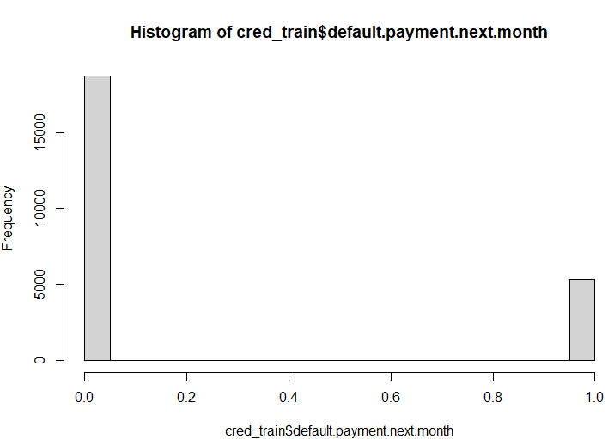
Training Data – EDA Response variable - Default
Training data is a random sample containing 80% of the overall data
Dimensions – 24000 rows with 23 columns
Values represent:
1 – Defaulted payment
0 – Not defaulted payment
Values | Count
0 | 18,685
1 | 5,315

Slide 5
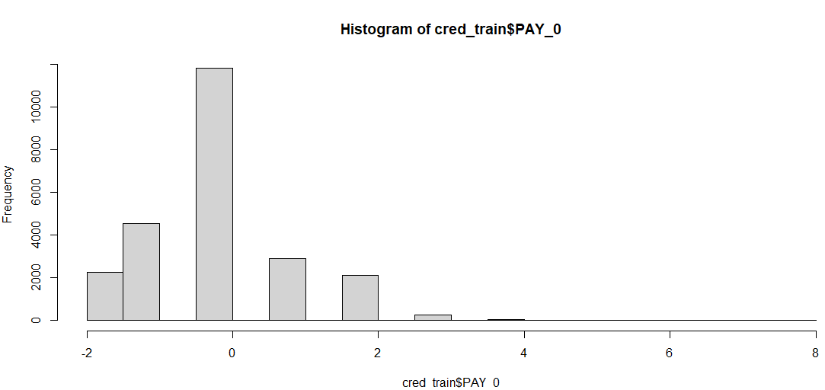
Training Data – EDA Predictor variable – PAY_0
There are 8 distinct categories ranging from -2 to 8.
Ordinal Categorical Variable
Amount of the given credit (NT dollar).
History of past payment beginning from September 2005 to April 2005.
The measurement scale for the repayment status is:
-2 = balance paid in full and no transactions;
-1 = balance paid in full and positive balance due to recent transaction;
0 = paid minimum amount;
1 = payment delay for one month;
2 = payment delay for two months; . . .
8 = payment delay for eight months
Values | Count
-2 | 2,250
-1 | 4,528
0 | 1,1808
1 | 2,912
2 | 2,135
3 | 256
4 | 57
5 | 22
6 | 8
7 | 8
8 | 16

Slide 6
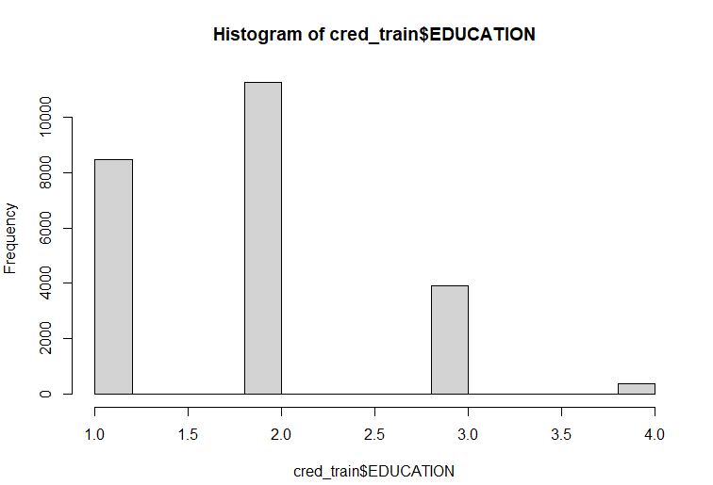
Training Data – EDA Response variable – EDUCATION
Values | Count
1 | 8,460
2 | 11,229
3 | 3,931
4 | 380
The range of categories range from 1 to 4
Describes the education qualification level
Ordinal Categorical variable
The measurement scale for education:
1 = graduate school;
2 = university;
3 = high school;
4 = others

Slide 7
Full Model vs Null model
Full Model
Deviance – 22,280.52
AIC – 22,334.52
BIC – 22,552.83
In-sample mean – 0.9294
Null Model
Deviance – 25,379.88
AIC – 25,381.88
BIC – 25,389.97
In-sample mean – 1.0575
 | Estimate | Std. Error | z value | Pr(>|z|)
(Intercept) | -8.60E-01 | 9.68E-02 | -8.88 | < 2e-16
LIMIT_BAL | -8.33E-07 | 1.77E-07 | -4.70 | 2.63E-06
SEX2 | -1.30E-01 | 3.44E-02 | -3.77 | 1.62E-04
EDUCATION2 | -9.87E-02 | 3.97E-02 | -2.49 | 1.29E-02
EDUCATION3 | -1.23E-01 | 5.32E-02 | -2.32 | 2.05E-02
EDUCATION4 | -1.01E+00 | 2.00E-01 | -5.06 | 4.16E-07
MARRIAGE2 | -2.59E-01 | 3.87E-02 | -6.68 | 2.45E-11
MARRIAGE3 | -2.72E-01 | 1.50E-01 | -1.82 | 6.95E-02
AGE | 3.80E-03 | 2.08E-03 | 1.82 | 6.83E-02
PAY_0 | 5.81E-01 | 1.98E-02 | 29.41 | < 2e-16
PAY_2 | 7.03E-02 | 2.26E-02 | 3.11 | 0.00
PAY_3 | 7.97E-02 | 2.53E-02 | 3.15 | 0.00
PAY_4 | 2.77E-02 | 2.79E-02 | 0.99 | 0.32
PAY_5 | 2.07E-02 | 3.01E-02 | 0.69 | 0.49
PAY_6 | 3.28E-03 | 2.49E-02 | 0.13 | 0.90
BILL_AMT1 | -6.49E-06 | 1.31E-06 | -4.96 | 0.00
BILL_AMT2 | 3.14E-06 | 1.69E-06 | 1.86 | 0.06
BILL_AMT3 | 1.42E-06 | 1.46E-06 | 0.97 | 0.33
BILL_AMT4 | -2.46E-07 | 1.51E-06 | -0.16 | 0.87
BILL_AMT5 | 1.71E-06 | 1.68E-06 | 1.02 | 0.31
BILL_AMT6 | -4.50E-07 | 1.31E-06 | -0.34 | 0.73
PAY_AMT1 | -1.39E-05 | 2.57E-06 | -5.39 | 0.00
PAY_AMT2 | -8.37E-06 | 2.24E-06 | -3.74 | 0.00
PAY_AMT3 | -3.02E-06 | 1.93E-06 | -1.57 | 0.12
PAY_AMT4 | -4.98E-06 | 2.04E-06 | -2.44 | 0.01
PAY_AMT5 | -1.48E-06 | 1.92E-06 | -0.77 | 0.44
PAY_AMT6 | -1.65E-06 | 1.41E-06 | -1.17 | 0.24
 | Estimate | Std. Error | z value | Pr(>|z|)
(Intercept) | -1.26 | 0.02 | -80.87 | <2e-16

Slide 8
Two – variable model
Two-Variable Model
Deviance – 22,798.63
AIC – 22,808.63
BIC – 22,849.06
In-sample mean – 0.9501
MODEL: default.payment.next.month ~ EDUCATION + PAY_0
 | Estimate | Std. Error | z value | Pr(>|z|)
(Intercept) | -1.43 | 0.03 | -49.01 | < 2e-16
EDUCATION2 | 0.06 | 0.04 | 1.56 | 0.12
EDUCATION3 | 0.11 | 0.05 | 2.28 | 0.02
EDUCATION4 | -1.05 | 0.20 | -5.27 | 0.00
PAY_0 | 0.73 | 0.02 | 45.51 | < 2e-16

Slide 9
Stepwise AIC and BIC
AIC
Deviance – 22,285.24
AIC – 22,325.24
BIC – 22,486.96
In-sample mean – 0.9293
MODEL: default.payment.next.month ~ LIMIT_BAL + SEX + EDUCATION + MARRIAGE + AGE + PAY_0 + PAY_2 + PAY_3 + PAY_4 + BILL_AMT1 + BILL_AMT2 + BILL_AMT5 + PAY_AMT1 + PAY_AMT2 + PAY_AMT3 + PAY_AMT4
BIC
Deviance – 22,311.82
AIC – 22,341.82
BIC – 22,463.1
In-sample mean – 0.9302
MODEL: default.payment.next.month ~ LIMIT_BAL + SEX + EDUCATION + MARRIAGE + PAY_0 + PAY_2 + PAY_3 + BILL_AMT1 + BILL_AMT2 + PAY_AMT1 + PAY_AMT2

Slide 10
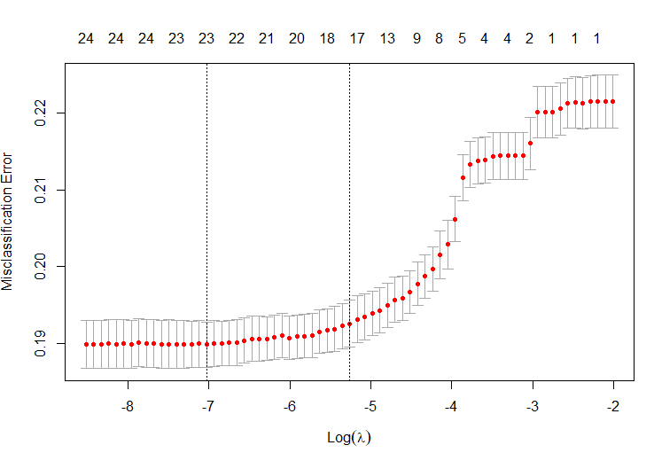
LASSO
Lambda.Min
Deviance – 27,842.78
AIC – 27,890.78
BIC – 28,090.19
In-sample mean – 0.9288
MODEL: default.payment.next.month~.-BILL_AMT2-BILL_AMT4-BILL_AMT6
Lambda.1se
Deviance – 27,917.22
AIC – 27,951.22
BIC – 28,092.47
In-sample mean – 0.9311
MODEL: default.payment.next.month~.-EDUCATION2-EDUCATION3-EDUCATION4-MARRIAGE3-PAY_6-BILL_AMT2-BILL_AMT3-BILL_AMT4-BILL_AMT5-BILL_AMT6

Slide 11
Summary
Based on the AIC, BIC, and in-sample mean values obtained, I would select stepwise AIC for modelling the predictions of given dataset
Method | Selected Variables | AIC | BIC | Model Mean Residual Deviance (in-sample)
Null Model | 1 | 25,381.88 | 25,389.97 | 1.0575
Full Model | . | 22,334.52 | 22,552.83 | 0.9294
Two-variable Model | EDUCATION+PAY_0 | 22,808.63 | 22,849.06 | 0.9501
Stepwise AIC | LIMIT_BAL + SEX + EDUCATION + MARRIAGE + AGE + PAY_0 + PAY_2 + PAY_3 + PAY_4 + BILL_AMT1 + BILL_AMT2 + BILL_AMT5 + PAY_AMT1 + PAY_AMT2 + PAY_AMT3 + PAY_AMT4 | 22,325.24 | 22,486.96 | 0.9293
Stepwise BIC | LIMIT_BAL + SEX + EDUCATION + MARRIAGE + PAY_0 + PAY_2 + PAY_3 + BILL_AMT1 + BILL_AMT2 + PAY_AMT1 + PAY_AMT2 | 22,341.82 | 22,463.1 | 0.9302
LASSO (lambda.min) | .-BILL_AMT2-BILL_AMT4-BILL_AMT6 | 27,890.78 | 28,090.19 | 0.9288
LASSO (lambda.1se | .-EDUCATION2-EDUCATION3-EDUCATION4-MARRIAGE3-PAY_6-BILL_AMT2-BILL_AMT3-BILL_AMT4-BILL_AMT5-BILL_AMT6 | 27,951.22 | 28,092.47 | 0.9311

Slide 12
Credit Card Default - Part B
Kothari Himanshi
M14529802

Slide 13
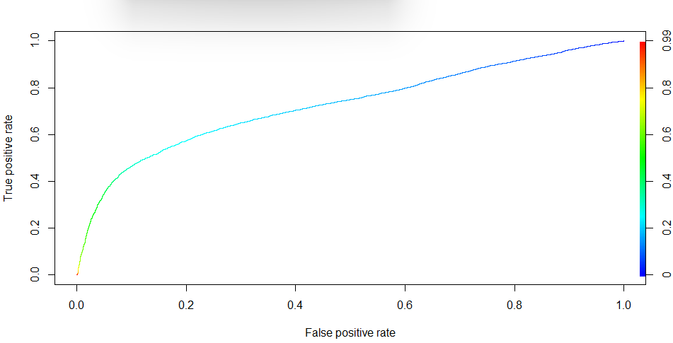
ROC Curve, AUC, and Asymmetric cost
AUC = 0.726
Since AUC > 0.7, it has a satisfactory discriminatory power
Cutoff probability = 1/2
Symmetric cost (Misclassification rate) = 0.189
Truth Table
Pred Actual | 0 | 1
0 | 18172 | 513
1 | 4025 | 1290

Slide 14
Asymmetric costs
Assumption – Cost ratio = 5:1 for credit card data
Cutoff probability = 1/6
Asymmetric cost is better measure than symmetric cost
Asymmetric cost = 0.678
Truth Table
Pred Actual | 0 | 1
0 | 8527 | 10158
1 | 1224 | 4091

Slide 15
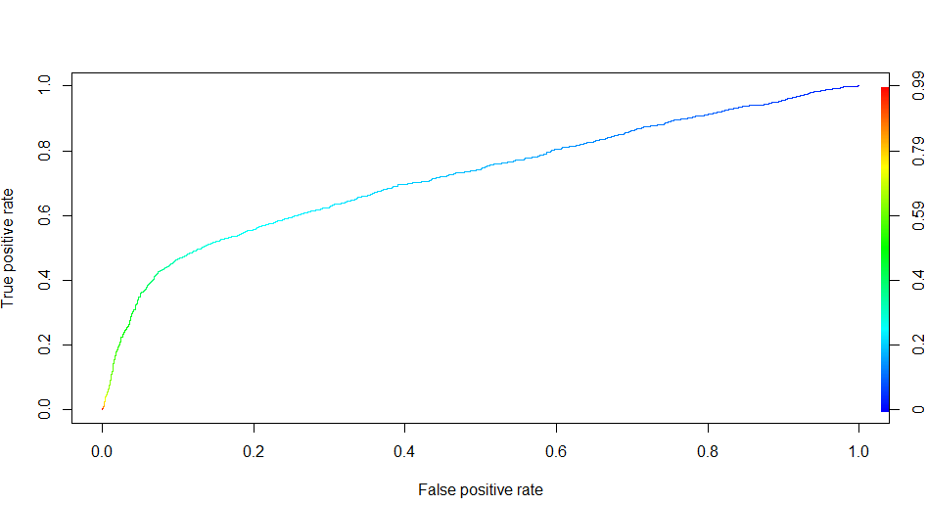
Out of Sample Testing
AUC = 0.721 > 0.7, which means it has satisfactory discriminatory power
Asymmetric cost = 0.678
Truth Table
Pred Actual | 0 | 1
0 | 2127 | 2552
1 | 303 | 1018
ROC Curve for test sample

Slide 16
Cross Validation & Summary
As per the summary table, we can see that the CV scores yield similar answer as out-of-sample testing AUC and asymmetric cost results for 20% testing sample
The reason being that the 20% testing sample would be the right representation of the entire dataset and validates the selected model
Random Seed ​ (80%/20%)​ | AUC ​ (in-sample)​ | AUC ​ (out-of-sample)​ | Asymmetric Cost​ (in-sample)​ | Asymmetric Cost​ (out-of-sample)​ | 5-fold CV​ (AUC)​ | 5-fold CV​ (Asymmetric Cost​)​
14529802​ | 0.726​ | 0.721​ | 0.678​ | 0.678​ | -​ | -​
Full data​ | 0.726​ | - | 0.682​ | -​ | 0.724​ | 0.684​
ROC Curve for test sample

Slide 17
Credit Card Default - Part C
Kothari Himanshi
M14529802

Slide 18
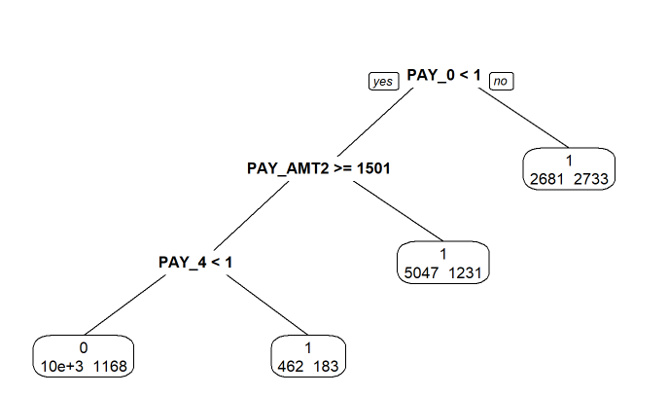
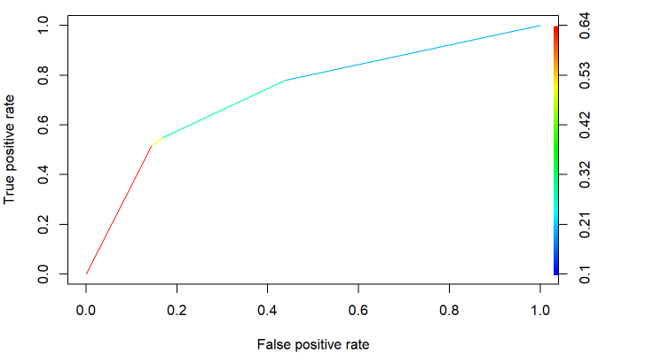
Classification Tree – Training data - ROC, AUC
Classification Tree for training data
The main predictor variables used to split the tree here are – PAY_0, PAY_AMT2, and PAY_4
Extreme right node – 2733 are number of observations correctly predicted as 1 and 2681 observations misclassified as 1
AUC = 0.726>0.7 => Satisfactory discriminatory factor
Asymmetric Cost = 0.682
Truth Table
Pred Actual | 0 | 1
0 | 10495 | 8190
1 | 1168 | 4147

Slide 19
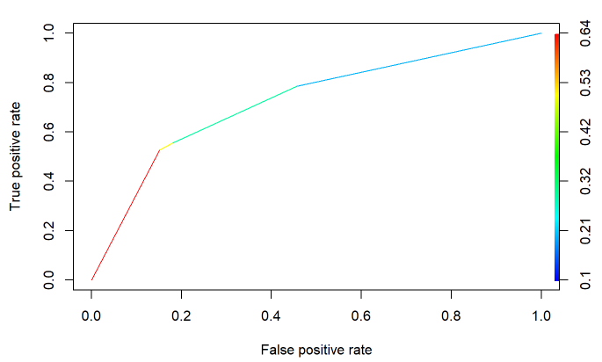
Out of Sample Testing and Compare
Classification Tree metrics
AUC = 0.726>0.7, Satisfactory discriminatory power
Asymmetric cost = 0.686
On comparing to the best model –
AUC = 0.721
Asymmetric Cost = 0.678
The model preferred here would be classification tree since the AUC is higher and asymmetric cost is almost equivalent and Trees are easier for the client to understand

Slide 20
Full Data & Summary
Classification Tree –
AUC = 0.725
Asymmetric cost = 0.682
Best initial model –
AUC = 0.725
Asymmetric cost = 0.678
Cross Validation –
AUC = 0.724
Asymmetric cost = 0.684
Random Seed ​ (80%/20%)​ | Method | AUC ​ (in-sample)​ | AUC ​ (out-of-sample)​ | Asymmetric Cost​ (in-sample)​ | Asymmetric Cost​ (out-of-sample)​ | 5-fold CV​ (AUC)​ | 5-fold CV​ (Asymmetric Cost​)​
14529802​ | Logistic | 0.726​ | 0.721​ | 0.678​ | 0.678​ | -​ | -​
 | Classification Tree | 0.726 | 0.726 | 0.682 | 0.686 | - | -
Full data​ | Logistic | 0.726​ | - | 0.682​ | -​ | 0.724​ | 0.684​
 | Classification Tree | 0.725 | - | 0.682 | - | - | -

Slide 21
Thank You!

